Slide 1

Movie Recommendation System
Presented By: Divya Rai (16it101)
Harita Shah (16it121)

Slide 2
Index
Introduction
Machine Learning
Unsupervised Learning
Supervised Learning
Types of Supervised Learning
Regression
Types of Filtering Technique
Collaborative Recommender System
Content based Recommender System
Basic Example
Basic Equation
Regularization
Dataset Manipulation
Print Data frames
Sorted Data frame
References

Slide 3
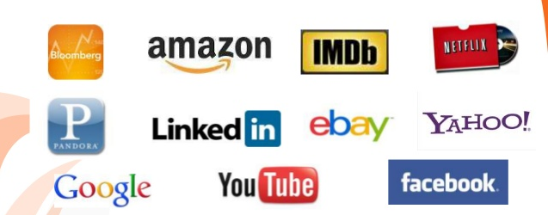
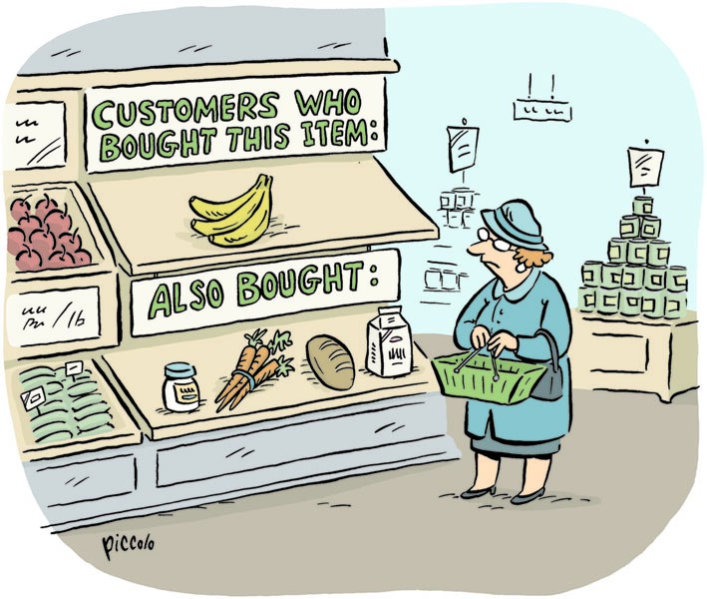
Introduction: Recommendation System
Recommendation system is a part of a big spectrum of Machine Learning.
They are information filtering systems that deal with the problem of information overload.
These systems filter vital information fragment out of large amount of dynamically generated information according to user’s preferences.

Slide 4
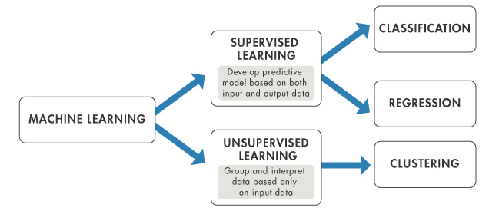
Machine Learning
Machine learning is an application of artificial intelligence (AI) that provides systems the ability to automatically learn and improve from experience without being explicitly programmed.

Slide 5
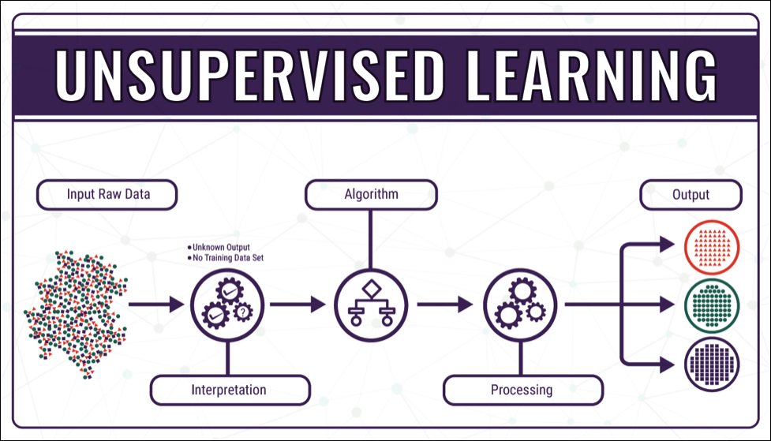
Unsupervised Learning
Unsupervised learning is the training of an artificial intelligence algorithm using information that is neither classified nor labelled and allowing the algorithm to act on that information without guidance.

Slide 6
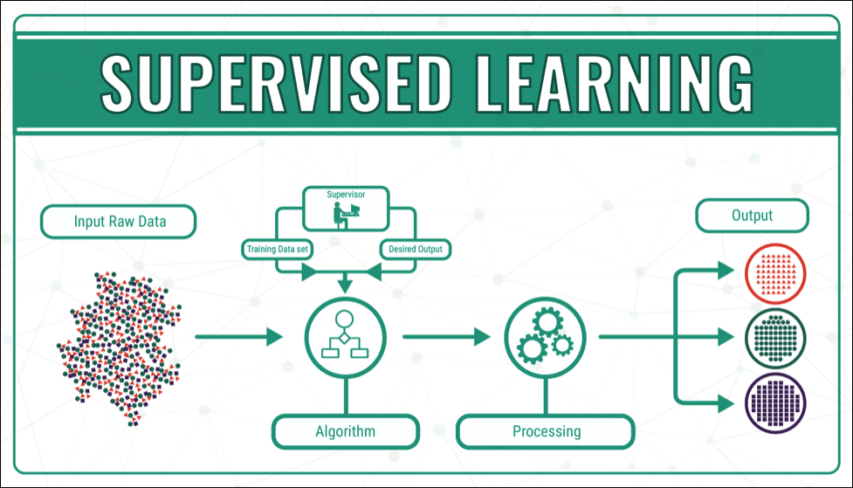
Supervised Learning
Supervised learning, in the context of machine learning, is a type of system in which both input and desired output data are provided.
Input and output data are labelled for classification to provide a learning basis for future data processing.

Slide 7
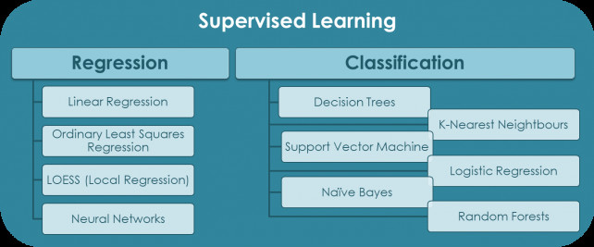
Types of Supervised Learning
Supervised learning is further divided into two division:
Classification
Regression

Slide 8
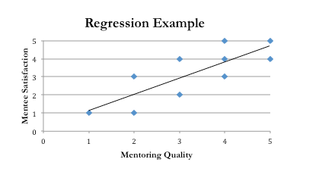
Regression
Regression is basically a statistical approach to find the relationship between variables.
In machine learning, this is used to predict the outcome of an event based on the relationship between variables obtained from the data-set.

Slide 9
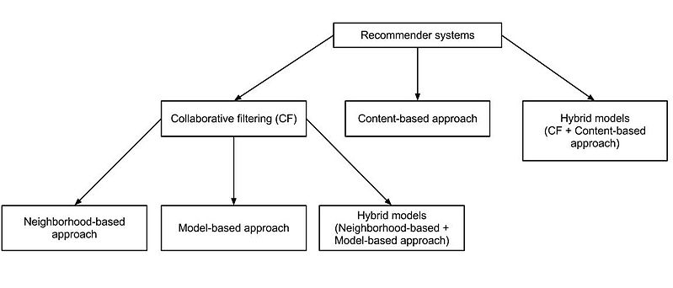
Types of Filtering Technique
There are mainly three types of filtering techniques:
Collaborative Recommender System
Content-based Recommender System
Hybrid Recommender System

Slide 10
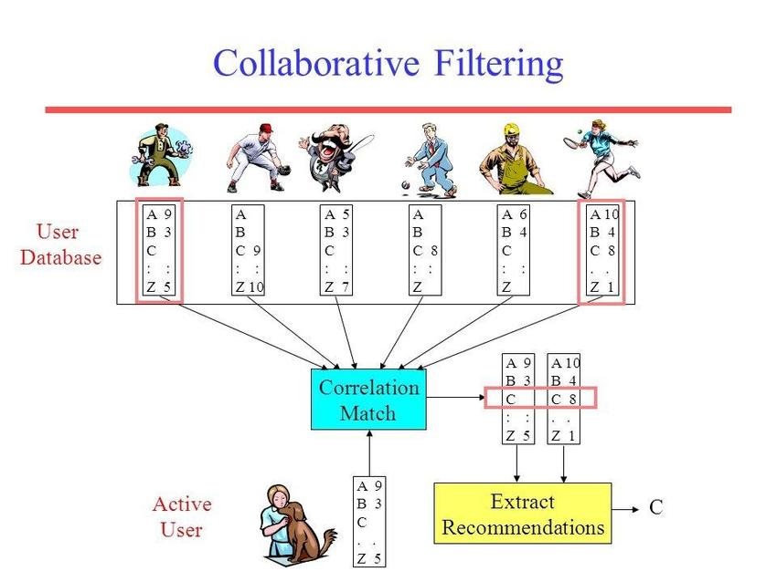
Collaborative Recommender System
Collaborative filtering , also referred to as social filtering, filters information by using the recommendations of other people.
It is based on the idea that people who agreed in their evaluation of certain items in the past are likely to agree again in the future.

Slide 11
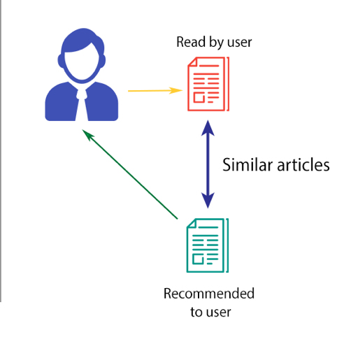
Content based Recommender System
Content-based filtering, also referred to as cognitive filtering, recommends items based on a comparison between the content of the items and a user profile.

Slide 12
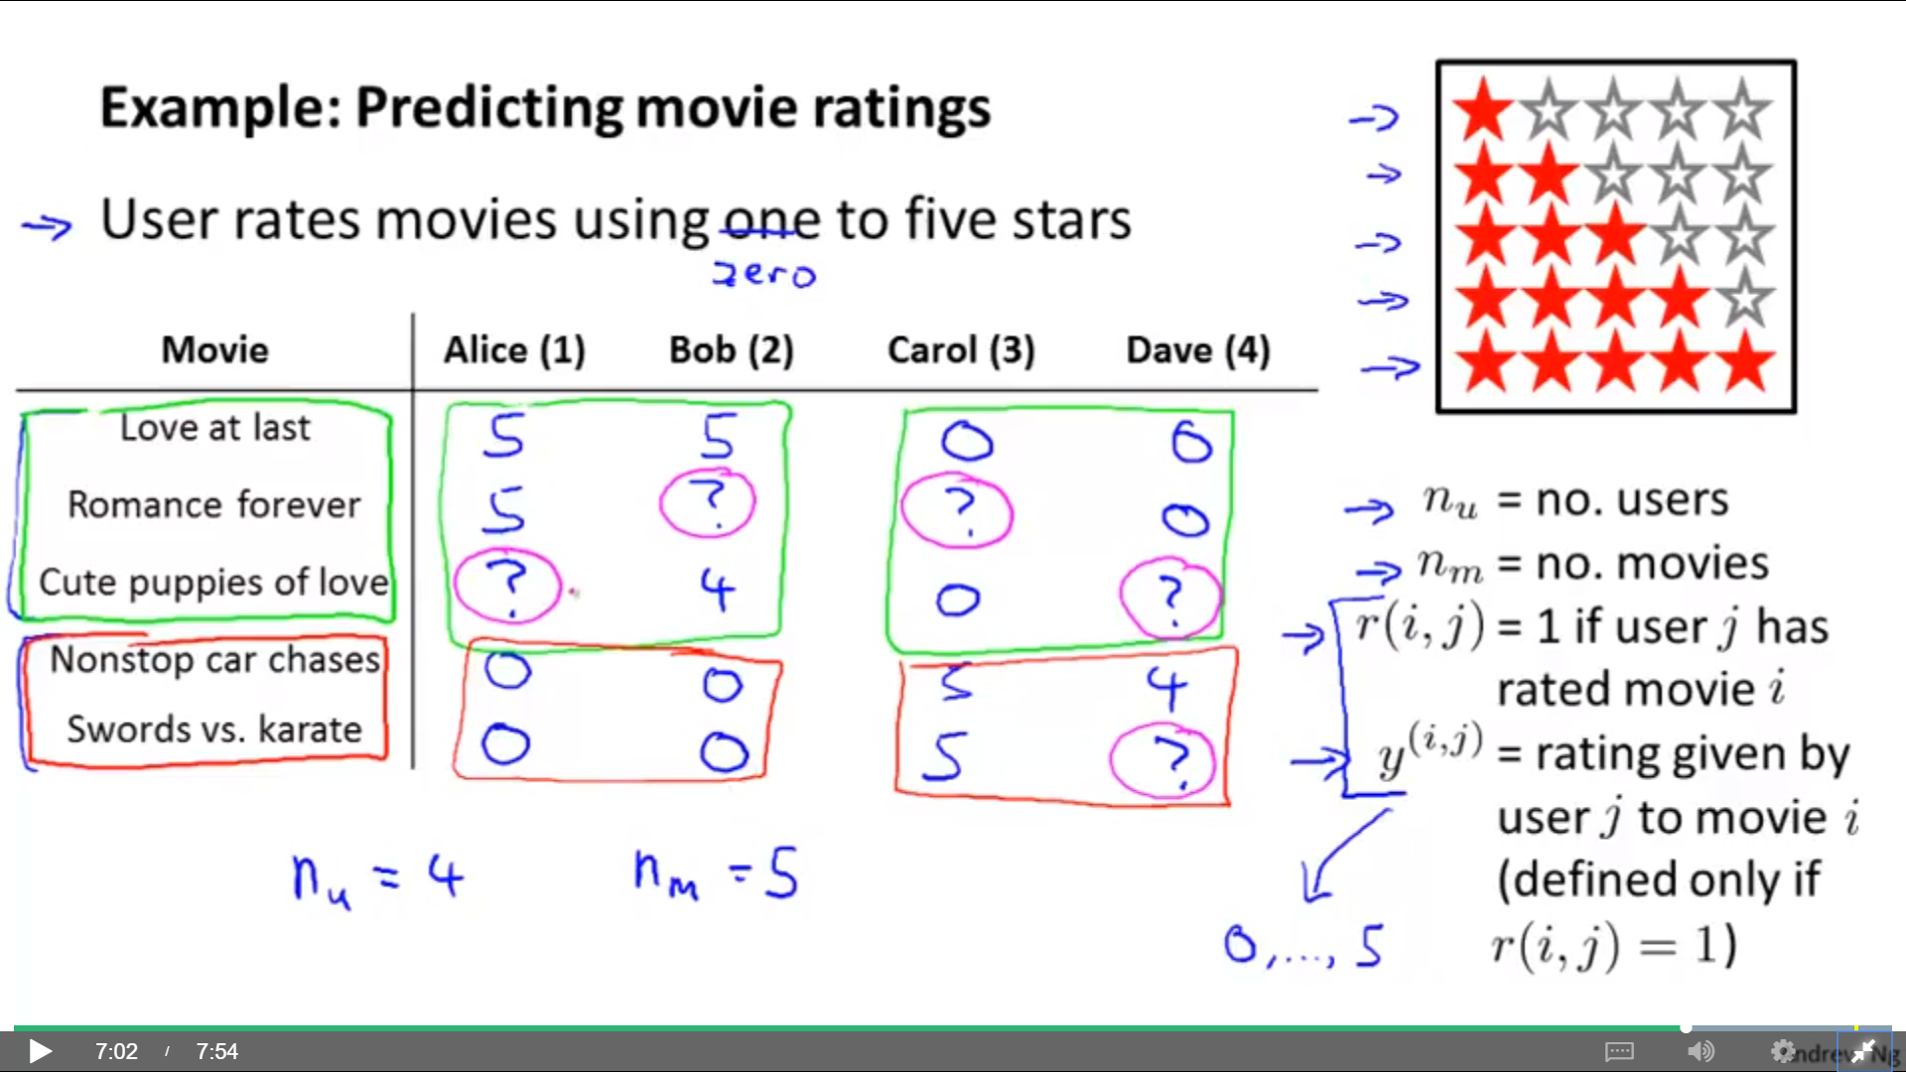
Basic Example

Slide 13
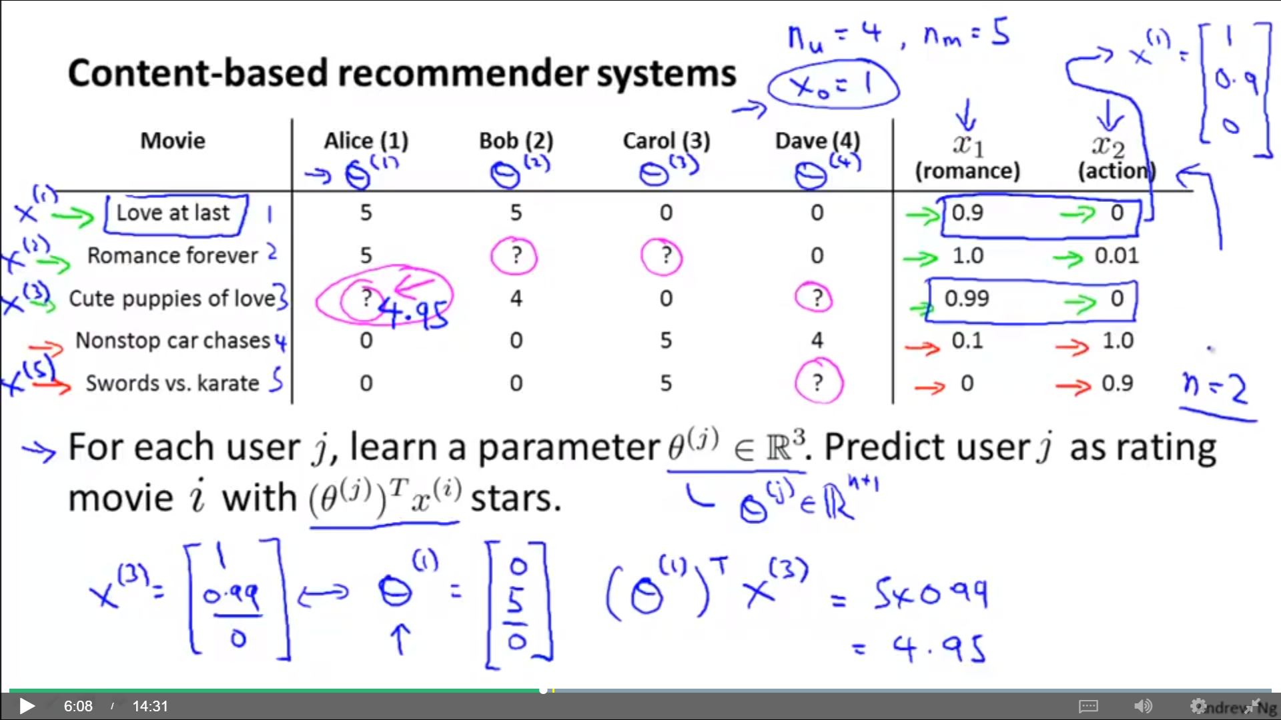
Basic Example

Slide 14
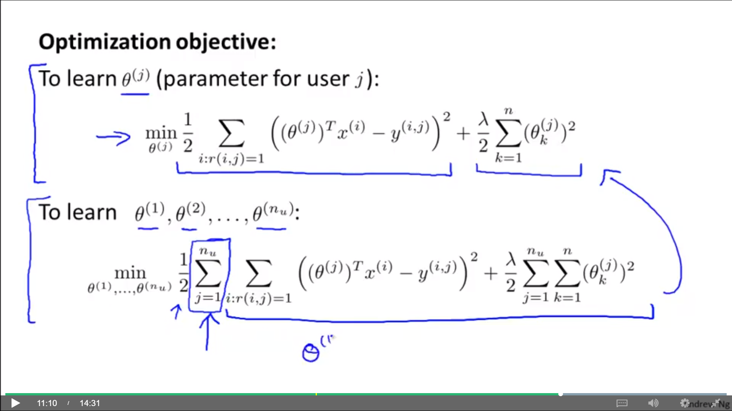
Basic Equation

Slide 15
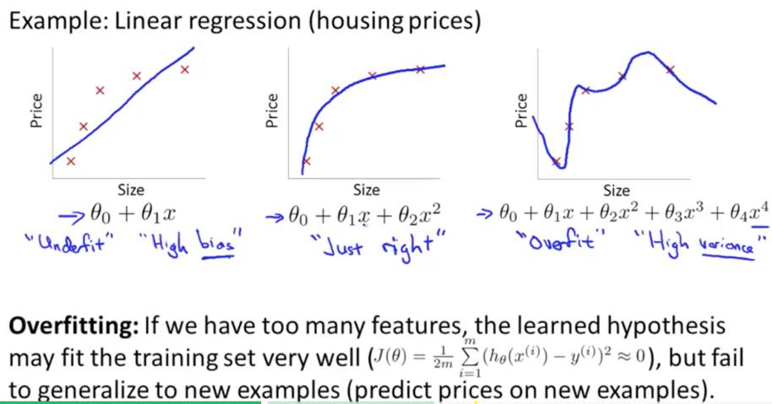
Regularization

Slide 16
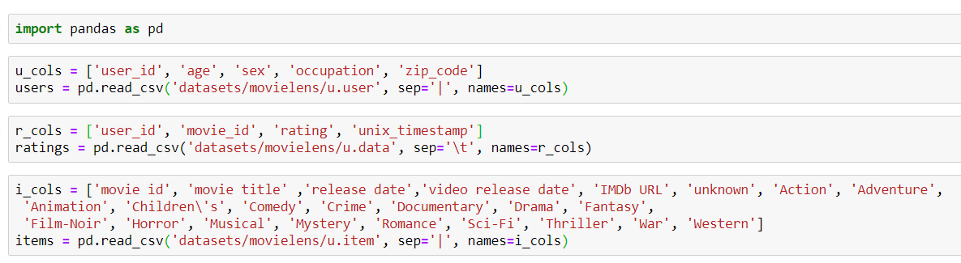
Dataset Manipulation

Slide 17
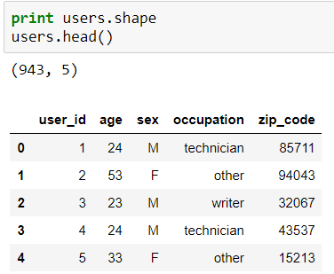
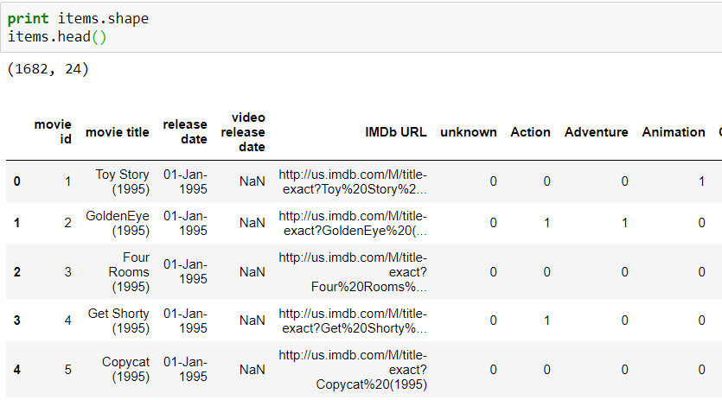
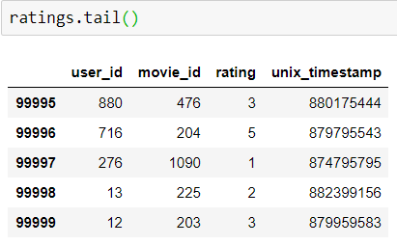
Print data frames

Slide 18
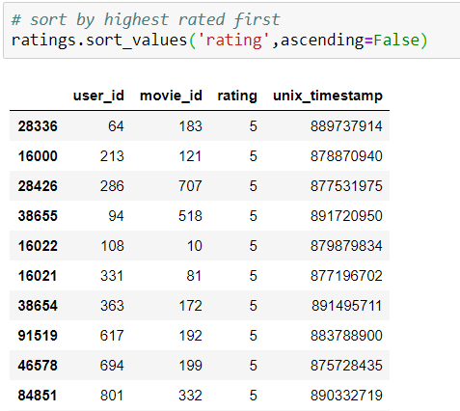
Sorted Data frame

Slide 19
References
https://www.sciencedirect.com/science/article/pii/S1110866515000341
http://recommender-systems.org/content-based-filtering/
https://www.coursera.org/learn/machine-learning/lecture/uG59z/content-based-recommendations
https://www.dataquest.io/blog/pandas-cheat-sheet/
https://www.analyticsvidhya.com/blog/2016/06/quick-guide-build-recommendation-engine-python/

Slide 20
Thank You

